Slide 1
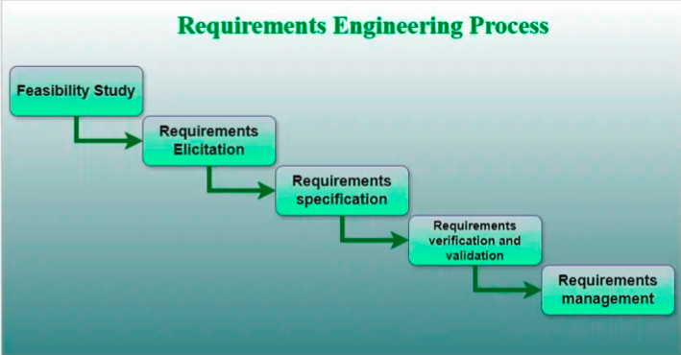
Requirements Engineering
A systematic and strict approach to the definition, creation, and verification of requirements for a software system is known as requirements engineering. To guarantee the effective creation of a software product, the requirements engineering process entails several tasks that help in understanding, recording, and managing the demands of stakeholders.

Slide 2
4. Requirements Verification and Validation
Verification: It refers to the set of tasks that ensures that the software correctly implements a specific function.
Validation: It refers to a different set of tasks that ensures that the software that has been built is traceable to customer requirements. If requirements are not validated, errors in the requirement definitions would propagate to the successive stages resulting in a lot of modification and rework.
The main steps for this process include:
* The requirements should be consistent with all the other requirements i.e.
no two requirements should conflict with each other.
* The requirements should be complete in every sense.
* The requirements should be practically achievable.

Slide 3
5. Requirements Management
Requirement management is the process of analyzing, documenting, tracking, prioritizing, and agreeing on the requirement and controlling the communication with relevant stakeholders. This stage takes care of the changing nature of requirements. It should be ensured that the SRS is as modifiable as possible to incorporate changes in requirements specified by the end users at later stages too. Modifying the software as per requirements in a systematic and controlled manner is an extremely important part of the requirements engineering process.
Requirements management is the process of managing the requirements throughout the software development life cycle, including tracking and controlling changes, and ensuring that the requirements are still valid and relevant. The goal of requirements management is to ensure that the software system being developed meets the needs and expectations of the stakeholders and that it is developed on time, within budget, and to the required quality.

Slide 4
Several key activities are involved in requirements management, including:
Tracking and controlling changes: This involves monitoring and controlling changes to the requirements throughout the development process, including identifying the source of the change, assessing the impact of the change, and approving or rejecting the change.
Version control: This involves keeping track of different versions of the requirements document and other related artifacts.
Traceability: This involves linking the requirements to other elements of the development process, such as design, testing, and validation.
Communication: This involves ensuring that the requirements are communicated effectively to all stakeholders and that any changes or issues are addressed promptly.
Monitoring and reporting: This involves monitoring the progress of the development process and reporting on the status of the requirements.
Requirements management is a critical step in the software development life cycle as it helps to ensure that the software system being developed meets the needs and expectations of stakeholders and that it is developed on time, within budget, and to the required quality. It also helps to prevent scope creep and to ensure that the requirements are aligned with the project goals.

Slide 5
Tools Involved in Requirement Engineering
Observation report
Questionnaire ( survey, poll )
Use cases
User stories
Requirement workshop
Mind mapping
Roleplaying
Prototyping

